Slide 1






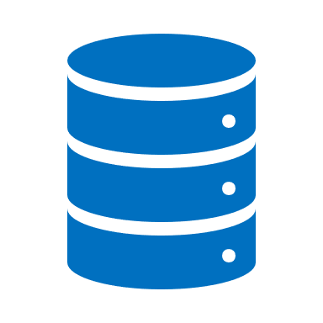





Containerized model deployment
Workload types
Online
Development
Call
API
ACS
AKS
Az API
Retrieved model deployment
Orchestrate job
Batch
(Airflow)
Data
source
Azure
Data
bricks
MLFlow
tracking
GIT HUB
COST
Management
Key vault
Monitor

